Slide 1

Specification Demo
EKE 749 Group Assignment 2
Team 6, Code Monkeys.

Slide 2


Code Monkeys
Notes:
Code Monkeys has two means.
First is an American animated television program created by Adam de la Peña. Set in the early 1980s, it follows the adventures of fictional video game company GameaVision.
Second, A Code monkey is a computer programmer or other person who writes computer code for a living. This term may be slightly derogatory, meaning that this developer can write some code but is unable to (or not supposed to) perform the more complex tasks of software architecture, analysis, and design^{[1]}. It is usually applied to junior programmers.

Slide 3

Introduce
Group name : Code Monkey
Project name : Monkey Calendar

Slide 4
Contents
Objective
Features
Environment

Slide 5
Monkey Calendar
Objective
  Write a calendar and appointment scheduler system.
    Add windowing (GUI) or browser interface, instead of just text
  Construct features, interface, limitation, etc..

Slide 6
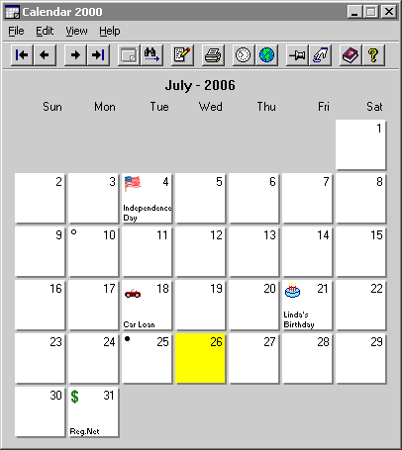
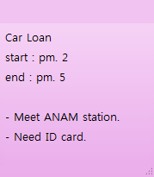
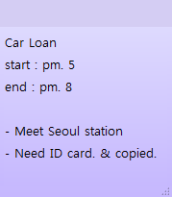
Monkey Calendar
Basic Requirements
Notes:
1 Print the calendar for any year, month, week, or range of days
2 Add an appointment with a given date, start time, finish time, short subject, and long description.
3 Change the details of any appointment
4 Clear the set of appointments

Slide 7
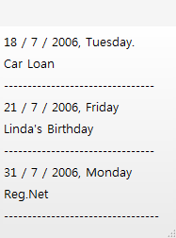

Monkey Calendar
Basic Requirements
Load
Appointment1.MC
Save
Notes:
5 Print all appointments for a given year, month, week, or day, printing either the short subject (for year or month) or long description (for week or day)
6 Save the set of all appointments to a file
7 Load one or more files, and modify, print, or save the loaded appointments from these files as described above

Slide 8
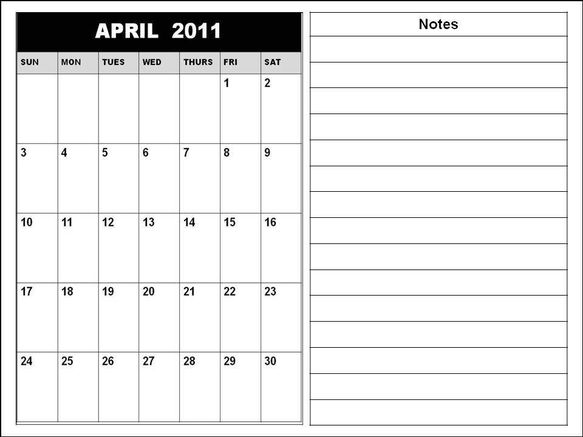
Monkey Calendar
Add additional fields
FEBRUARY
Name
Car Loan
Day
2 / 4 / 2011
Start
Pm. 5
End
Pm. 8
Location
Seoul station
People
Car manager
Need ID card & copied
Description
Notes:
- Add additional fields, such as location, people attending, etc.

Slide 9
Monkey Calendar
Allow repeating Appointments
FEBRUARY
Name
Volunteer Work
Day
2 / 9 / 2011
Start
MARCH
Pm. 2
End
Pm. 7
Location
Korea univ.
People
Colleague
Sometimes location will be changed.
Memo
Notes:
- Allow repeating Appointments (every Friday at 10:00, every January 1 at 0:00, every hour for 1 day)

Slide 10

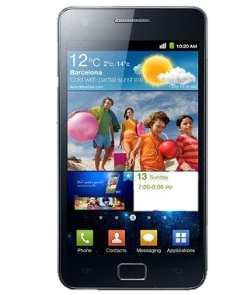
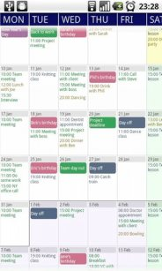
Monkey Calendar
Add windowing (GUI) interface : android
Notes:
- Add windowing (GUI) or browser interface, instead of just text : Android

Slide 11
Monkey Calendar
Allow appointment to span multiple days
FEBRUARY
Name
Team meeting
Day
2 / 4 / 2011
2 / 4 ~ 2 / 8
Start
Pm. 5
End
Pm. 8
Location
Room. 312
People
Description
Notes:
- Allow appointment to span multiple days

Slide 12
Monkey Calendar
Report if two appointments are at the same time
FEBRUARY
Name
Volunteer Work
Name
Team meeting
Day
2 / 4 / 2011
Day
2 / 4 / 2011
Start
Pm. 2
Start
Pm. 5
End
Pm. 7
End
Pm. 8
Location
Korea univ.
Location
Room. 312
People
Colleague
People
Is it OK?
Sometimes location will be changed.
Description
Description
Notes:
- Report if two appointments are at the same time

Slide 13
Monkey Calendar
Allow appointment to span multiple days
MAY
Lunar Calendar
4 / 4 / 2011
Children’s day
Lunar Calendar
4 / 8 / 2011
Buddha's Birthday
Lunar Calendar
4 / 18 / 2011
Notes:
- Allow appointment to span multiple days

Slide 14
Monkey Calendar
July
MARCH
Add Tasknote
Keep household accounts
Write self-introduction
Repair notebook

Slide 15
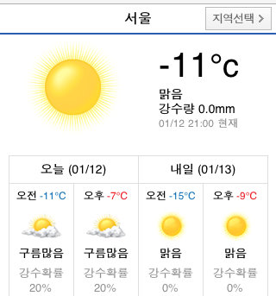
Monkey Calendar
Add day’s information
Biorhythm
Weather
My fortune
Link
Notes:
- Allow appointment to span multiple days

Slide 16
Monkey Calendar
Add additional language (optional)
FEBRUARY
MARCH
Volunteer Work
Name
Volunteer Work
Name
Day
3 / 9 / 2011
Day
2 / 9 / 2011
Start
Pm. 2
Start
Pm. 2
Pm. 7
End
Pm. 7
End
Location
Korea univ.
Location
Korea univ.
People
Colleague
People
Colleague
Sometimes location will be changed.
Sometimes location will be changed.
Description
Memo
Notes:
- Add time zones, and additional languages (for example, both Korean and English) (optional)

Slide 17
Monkey Calendar
Add additional language (optional)
FEBRUARY
내용
3월
Volunteer Work
제목
Volunteer Work
Name
일
월
화
수
목
금
토
날짜
3 / 9 / 2011
Day
2 / 9 / 2011
시작시간
Pm. 2
Start
Pm. 2
Pm. 7
끝 시간
Pm. 7
End
장소
Korea univ.
Location
Korea univ.
사람
Colleague
People
Colleague
Sometimes location will be changed.
Sometimes location will be changed.
추가 설명
Memo
Notes:
- Add time zones, and additional languages (for example, both Korean and English) (optional)

Slide 18
Monkey Calendar
Environment
  Android version : 2.1
  Resolution : 800 x 480 WVGA
  Input device : touch, virtual keyboard
Notes:
- Add additional fields, such as location, people attending, etc.
- Allow repeating Appointments (every Friday at 10:00, every January 1 at 0:00, every hour for 1 day)
- Add windowing (GUI) or browser interface, instead of just text : Android
- Allow appointment to span multiple days
- Report if two appointments are at the same time
- Add time zones, and additional languages (for example, both Korean and English) (optional)

Slide 19

Ask me anything!

